Slide 1
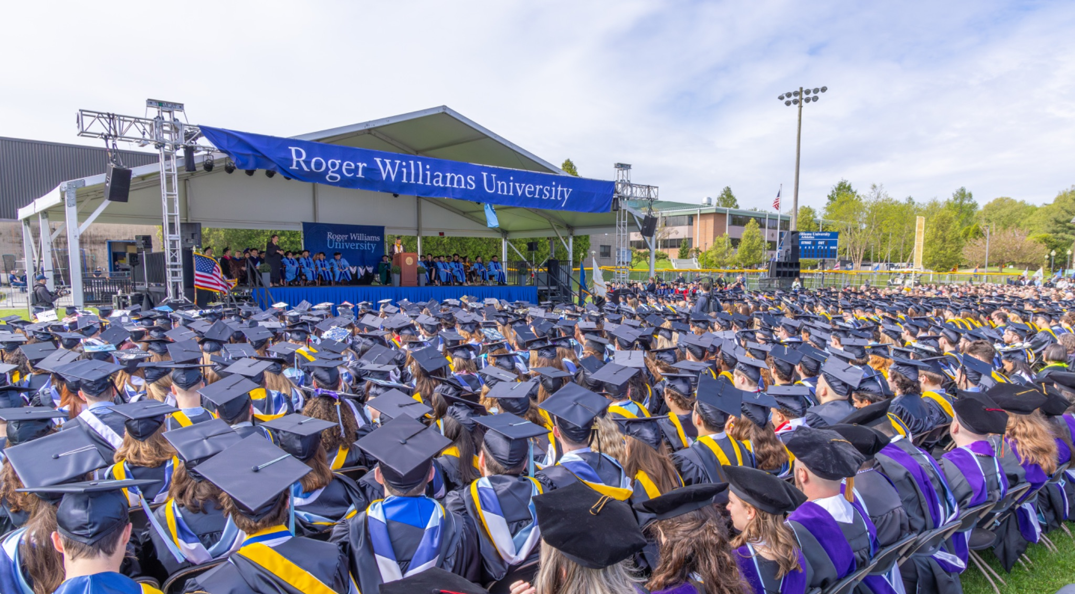


COMMENCEMENT SOCIAL MEDIA KIT
CELEBRATING THE CLASS OF 2025
©2025 Roger Williams University. All Rights Reserved.

Slide 2
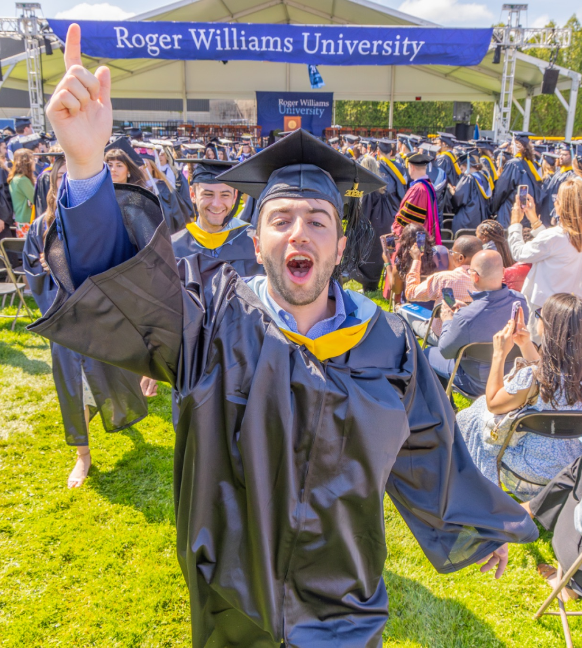
SHARE YOUR STORY.
We’d love to see your view of the day, from cap tosses to candid moments. Tag us so we can celebrate with you!
Facebook, LinkedIn, TikTok: @Roger Williams University, @Roger Williams University School of Law, @RWU Extension School
Instagram, Threads, X: @myRWU, @RWULaw, @RWUExt
Whether it’s a favorite quote, a proud family photo, or a moment of joy, your perspective helps tell the story of #RWU2025.

Slide 3
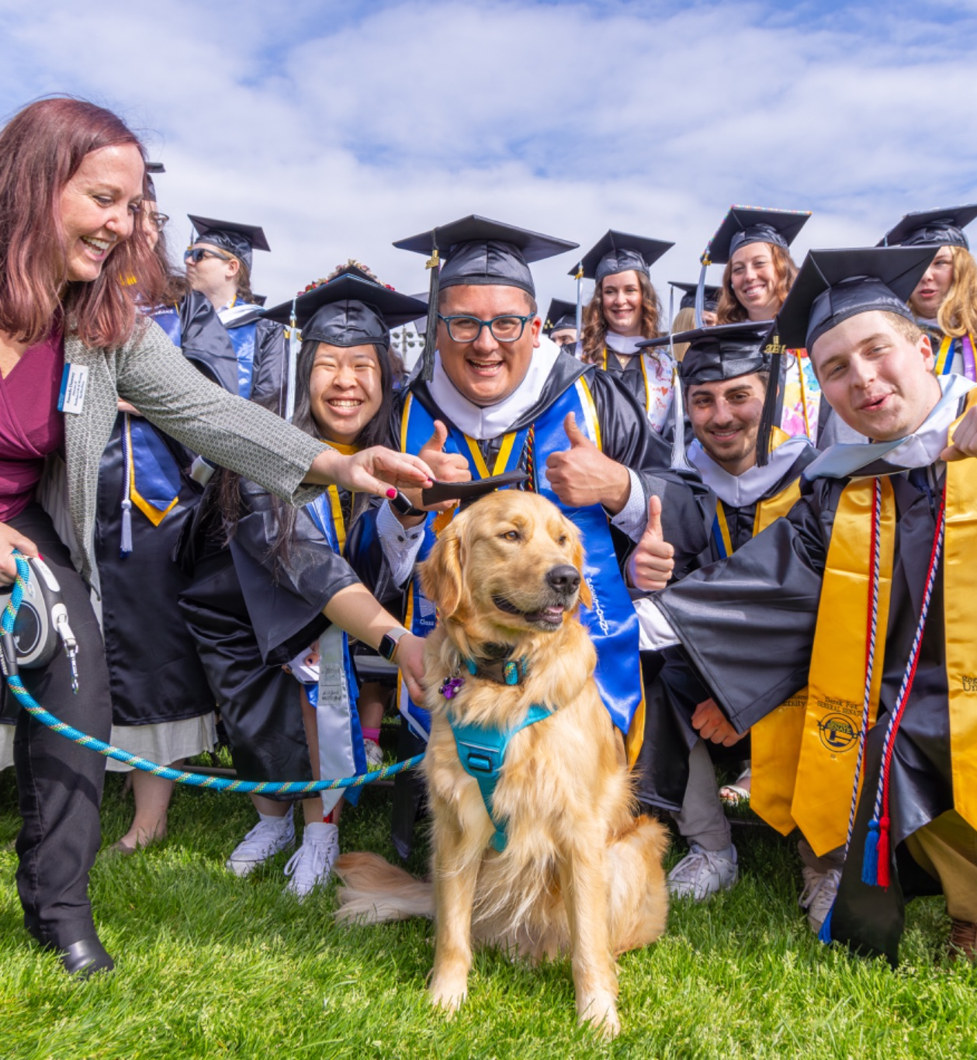
OFFICIAL HASHTAGS
Use our branded hashtags to contribute to a shared memory bank that will last a lifetime, allowing everyone to easily find and engage with each other's stories, photos, and milestones.
INSTAGRAM/FACEBOOK:
#RWU2025
#RWULaw2025
#RWUGrad
LINKEDIN:
#RWU2025
#RWULaw2025
#RWUGrad
TIKTOK:
#RWU2025
#RWUGrad

Slide 4
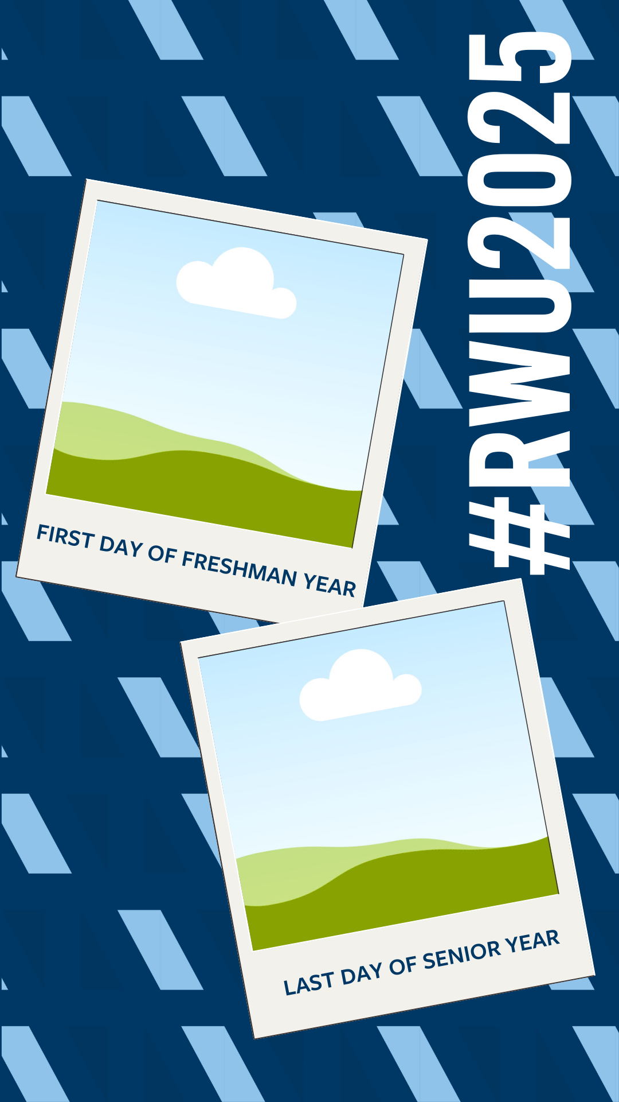

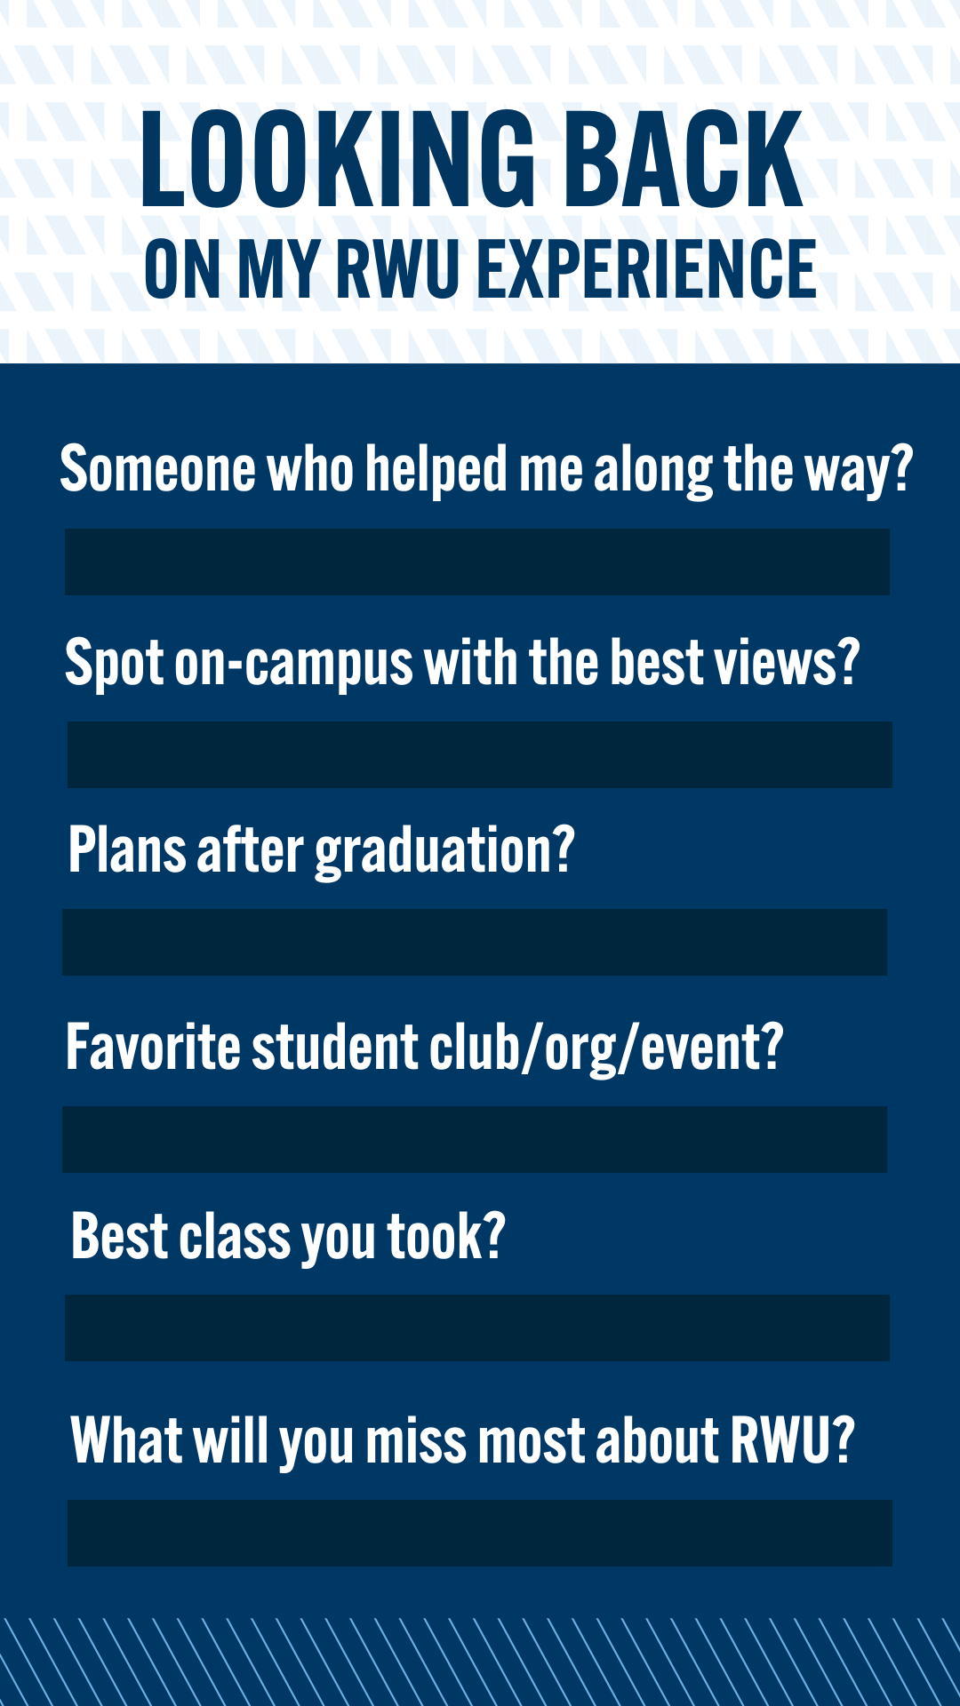
INSTAGRAM STORIES TEMPLATES
Celebrate Commencement with ready-to-use Canva graphics, perfect for grads, families and friends. Tap the graphics below to access the templates.

Slide 5
CAPTIONS & COPY SUGGESTIONS
FACEBOOK CAPTIONS:
INSTAGRAM CAPTIONS:
Next stop, [insert future plans]! 🎓💙
Once a hawk, always a hawk 🎓🦅
Manifested this moment since orientation. 💫📘
That cap + gown glow ✨ #RWU2025
Chapter 1: Roger Williams University Chapter 2: Loading… ⏳📖
Leaving the nest, chasing the rest 💫
Main character arc: complete 🎬🎓
Real-world ready, RWU style 💼🎓
🎓 That’s a wrap, RWU! Four years of late nights, lifelong friendships, and unforgettable memories. Here’s to the Class of 2025! 💙
We came. We studied. We graduated. So proud to be part of the Roger Williams University Class of 2025! Time to fly, Hawks! 💙🎉
Cheers to the late nights, early mornings, and everything in between. Roger Williams, you’ll always be home. 🎓 RWU Class of 2025, we did it! 💙
From first-year move-in to the graduation stage, what a journey. Roger, thank you for shaping who I am today. Here’s to new adventures!

Slide 6
CAPTIONS & COPY SUGGESTIONS
LINKEDIN CAPTIONS:
I’m proud to graduate from RWU with a degree in [Your Major]! Next up: [Starting a new role at ___ / Pursuing my master’s in ___ / Taking time to travel / Exploring new opportunities]. Grateful for the support, growth, and memories from the last few years. Here’s to what’s ahead!
It’s official! I’ve earned my degree from Roger Williams University. Thank you to my professors, mentors, and friends who helped me get here. Excited for what’s next.
Excited to share that I’ve graduated from RWU with my degree in [Your Major]. I'll be starting my next chapter as a [Job Title] at [Company Name] / pursuing a graduate degree in [Field] / [Other Next Step].
🎓 Ready to soar!
RWU gave me the confidence, connections, and real-world experience to chase what’s next. Next stop: [Job/Grad School/Next Chapter]
🦅 Four years. Countless experiences. Powerful combinations.
Grateful for a journey that blended passion + purpose — and launched me toward [Next Step]!

Slide 7
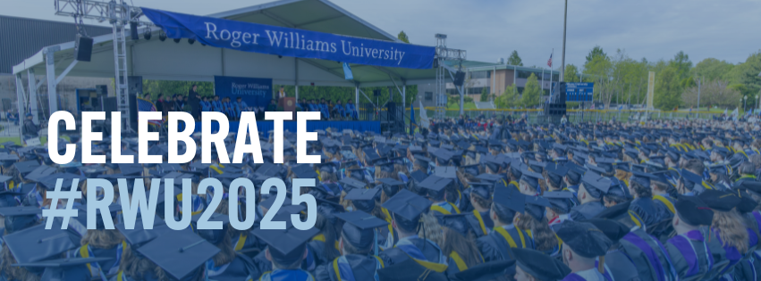


SOCIAL COVER PHOTOS
Celebrate Commencement with custom Canva cover photos, for grads, families, and friends to show their pride on Facebook and LinkedIn.

Slide 8
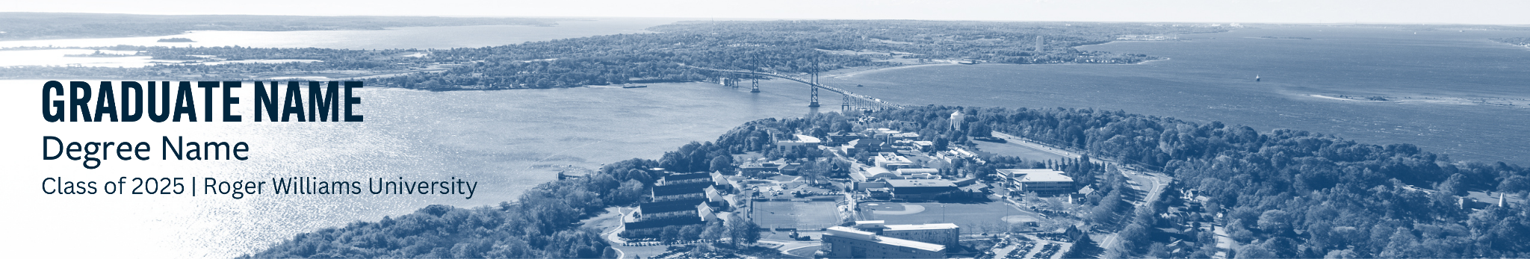

LINKEDIN BANNERS
Whether you’re job searching or celebrating, these banners are a great way to mark the moment.

Slide 9
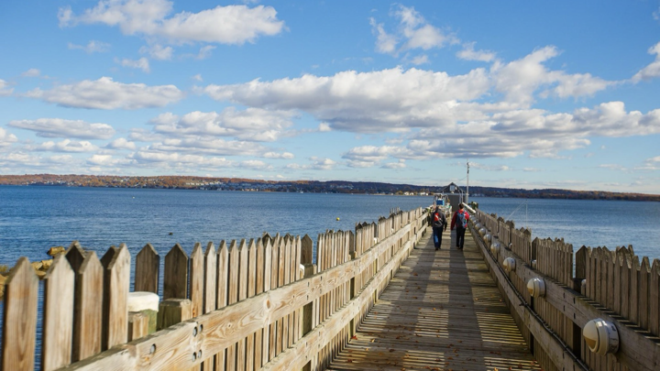

SELFIE STOPS + JUMBO RWU LETTERS
Scenic on-campus photo spots to capture memories with your friends and family!
SELFIE STOPS:
Roger Williams Statue on D’Angelo Commons
RWU Sailing Center
RWU Front Sign
Scenic Overlook on the Side of of Global Heritage Hall
JUMBO RWU LETTERS:
On Commons Quad
(RWU Law Jumbo Letters) In Front of RWU Law Building
Notes:
We understand that attending college is a financial investment, so we like to highlight the value in the dollar amount that you’re spending on your education. *read through columns*

