Slide 1

BlueCare Connect – a new Blue Cross Wellness Portal for Roger Williams University
2025-2026 – BlueCare Connect

Slide 2



BlueCare Connect for RWU
Wellness Incentive – Simplified with New Point System
 | Activity | Points
Benefits | Annual Well-Visit | 500
 | Dental Cleaning | 250
 | Health Assessment Survey | 200
 | Sample Additional Activities | 1050
 | Total Points Needed: | 2,000
Explore & Earn | 125
Welcome Points (new users only) | 150
12 Events or Webinars (self-reported) | 600
Track 5k steps a day | 5 points/daily
Track 2 Healthy habits per week | 10 points/weekly

Slide 3


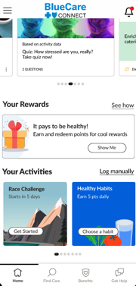
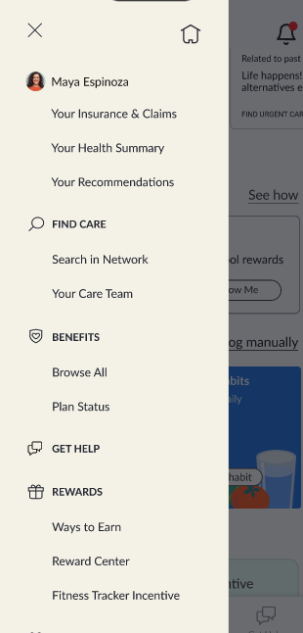
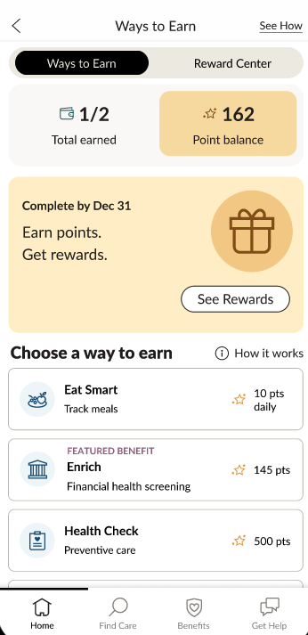
Earning Points
BlueCare Connect offers a variety of ways to earn points for doing health and wellbeing activities.
Earn points for your annual well-visit and screenings, health assessment, and tracking your daily activities like steps, food and sleep, and completing actions within the app.
The more you use BlueCare Connect, the more points you get!
From the Home screen, click Your Rewards and select the Ways To Earn tab.
You can also navigate to Ways To Earn from the
menu on the Home screen.

Slide 4
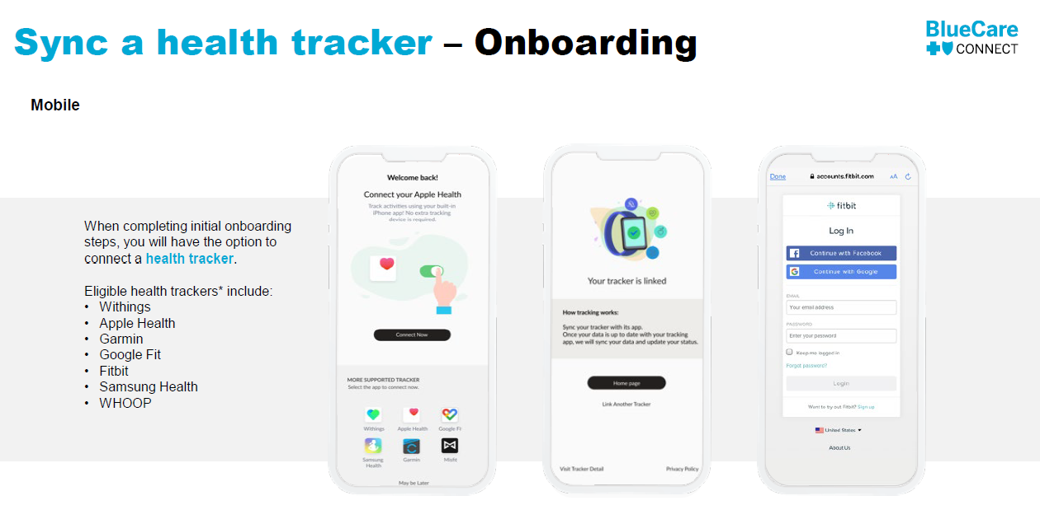
BlueCare Connect for RWU
Connect a Tracker

Slide 5


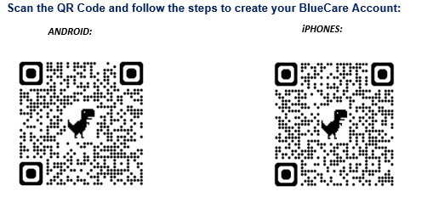
Or click this link: BlueCare Connect

